Slide 1
DBMS PROJECT
BLOOD BANK MANAGEMENT SYSTEM
Group Number-34

Slide 2
TEAM MEMBERS
Vedurupaka Venkata Sai - B210437CS
Nimmalapudi Leela Krishna - B210569CS
Kusumanchi V S S K Lokesh Gupta - B210539CS
Utkarsh Kumar - B210559CS

Slide 3
INTRODUCTION
BBMS is a tool designed to make managing blood donations and requests a breeze. Our system simplifies tasks like creating donor records, processing requests, and keeping track of available blood units. It even allows donors to log in, and administrators can easily manage donor information. With real-time updates on blood inventory and secure logins, our BBMS ensures a safe and efficient blood management process.

Slide 4
USERS
Donor
Patient
Admin

Slide 5
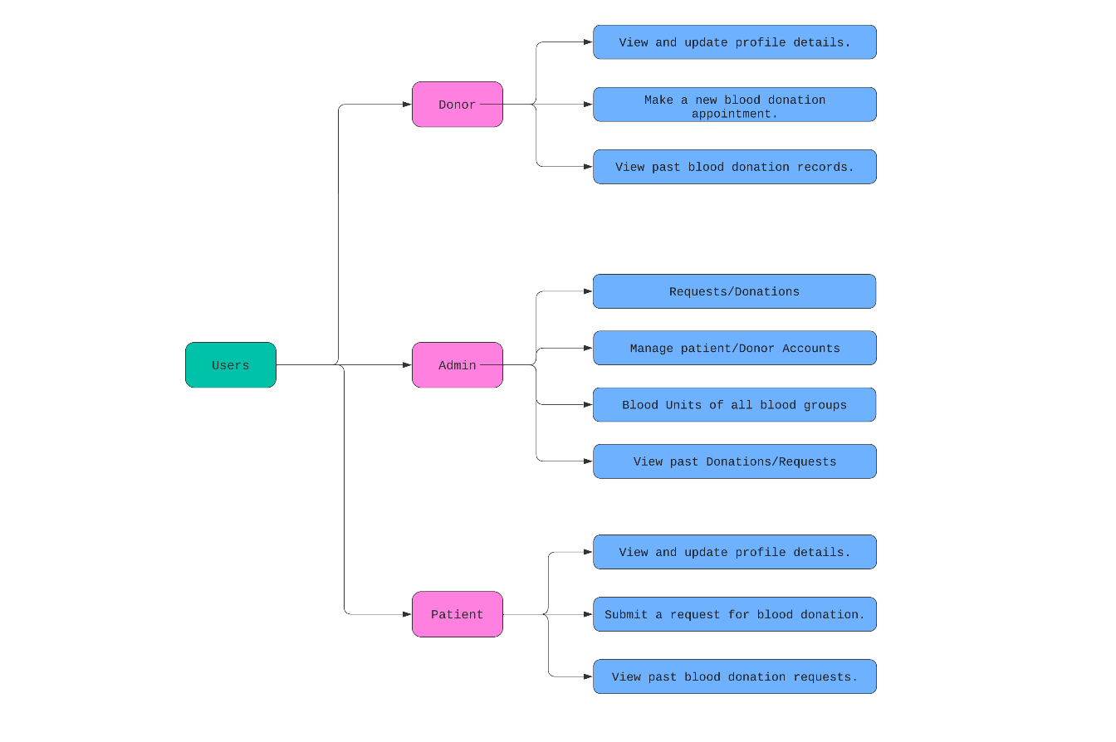

Slide 6
FUNCTIONALITIES OF THE PRODUCT
For Users (Patients and Donors):
Request Blood: Patients can request specific blood types with units.
View Donation History: Donors can access their donation history, keeping them informed about their contribution.
View Request History: Patients can access their request history, keeping them informed about their requests.
Update Personal Information: Patients and donors can update their contact details or eligibility criteria.
Donate Blood: Donors have the option to donate blood, contributing to the blood bank inventory.

Slide 7
FUNCTIONALITIES OF THE PRODUCT
For Users (Admin):
View Available Blood Inventory: Admin can check the current stock of available blood units.
Manage Donor Records: Admins can view, edit, or delete donor records, ensuring an accurate and up-to-date donor database.
Process Blood Requests: Admins have the authority to process blood requests, specifying recipient details and required blood type.
Update Blood Inventory: Admins can add new blood units to the inventory and update existing records.
View Transaction History: Admins can access a comprehensive transaction history, tracking all blood-related activities.

Slide 8
ASSUMPTIONS
The data for all blood units and registered users will be stored in a database.
The BBMS will be designed for continuous availability, ensuring that users can access the system at any time.This is critical in emergency situations where quick access to blood resources is essential.
The BBMS interface will be entirely in English, as users are expected to have a working proficiency in the language.
Administrators are assumed to have a basic understanding of the system's functionalities.
As a web-based application, the BBMS requires an internet browser for access.Users are expected to have a decent internet connection, and basic familiarity with handling a keyboard and mouse is assumed.
The database must be promptly updated upon actions such as issuing, renewing, or blood donation.

Slide 9
CONSTRAINTS
The design contain the following constraints:
Development and Maintenance Constraints:The BBMS software is exclusively designed, delivered, and maintained by the project team.
Admin Access Constraints:Admin access to the system is protected with unique and secure credentials, ensuring the security and integrity of admin-related functions.
User Role-Based Dashboard Constraints: Each employee or user has different credentials and is provided with a personalized dashboard that aligns with their specific role and responsibilities within the system

Slide 10
ER DIAGRAM

Slide 11
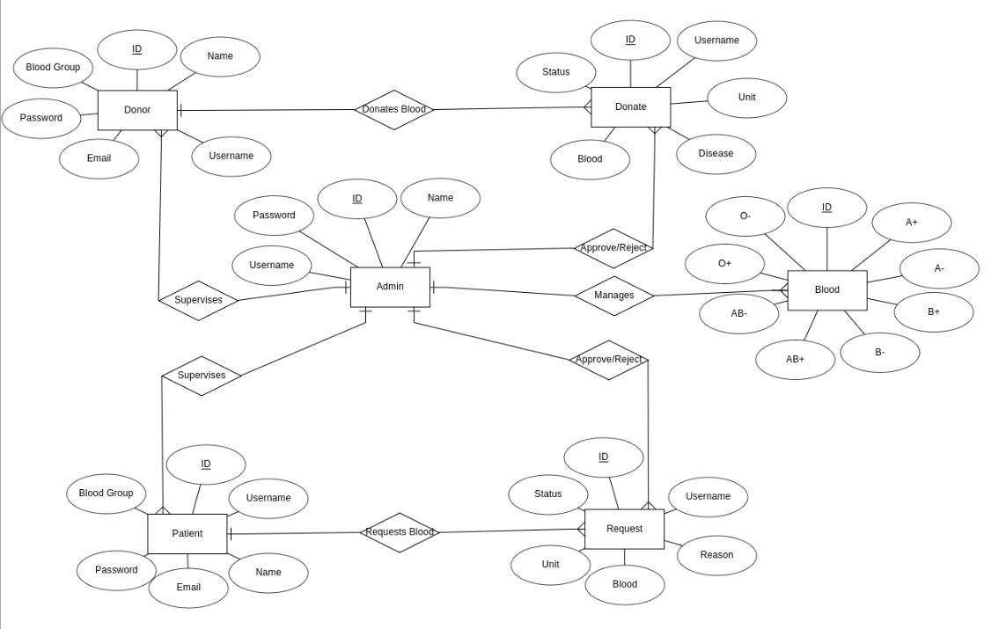

Slide 12
RELATIONAL SCHEMA

Slide 13
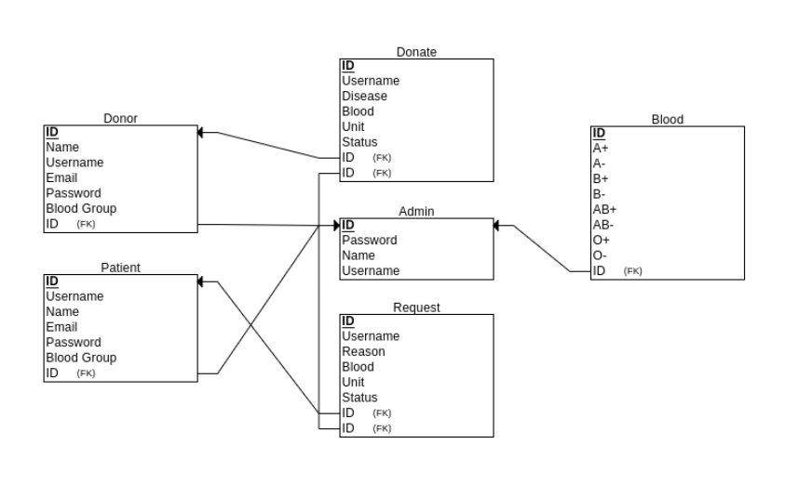

Slide 14
SCHEMA DESCRIPTION

Slide 15
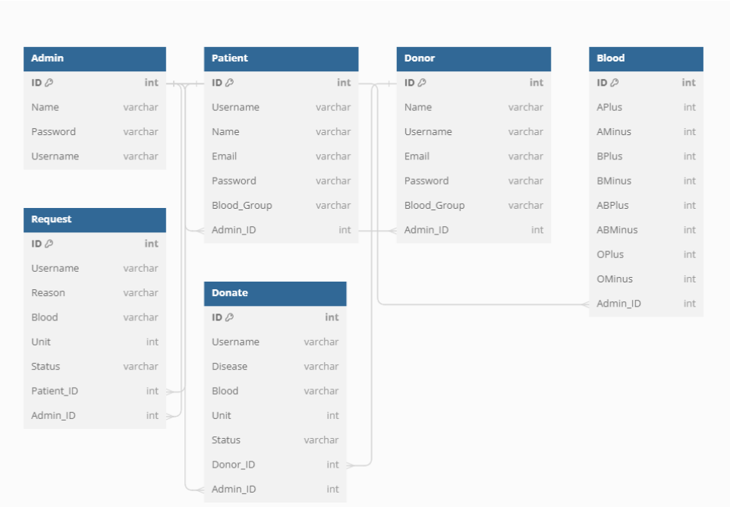

Slide 16
THANK YOU!

